Slide 1

ClearanceJobs Connect 2023
INTRODUCTION
Notes:
Softball about Who Got Hires or offers going out today?
I am really excited to be here today amongst a really unique set of recruiters
I love speaking to all recruiters, but us in the cleared recruiting community are what I consider to be the best of breed
So a couple of baselines I want to talk about before we dive in…
Cleared recruiting is not getting any easier, Reciprocity is never happening, Time to clear folks may get quicker…but not nearly as fast as we need it to make a difference in supply and demand and there is no Recruiting technology outside of ClearanceJobs that is going to make our jobs drastically easier…
The biggest impact we can make is through becoming better recruiters. Holding positions of influence and improving our process.
As I was preparing for this talk, I looked back through some previous talks I have given and had the pleasure of attending at various events through the years

Slide 2
“If you don’t know how to ask the right question, you discover nothing”
“Start with your Highest ROI when sourcing”
”All Searches Return Results”
“Sourcing is about including AND excluding what you want to see”
INTRODUCTION

Slide 3
🐿 It All Starts with the Search
🤖 Building an Army of Robots
☎️ Outreach
🔮 Become a Trusted Advisor
AGENDA

Slide 4

A Little About Me
HI, I’m Tommy Weinert
Recruiting and training for 15 years in DOD TA
Took part in Thousands of Hires
Seen some of the best and some of the worst
Founded Mount Indie in 2018
Notes:
Started as a recruiter and leveraged that into a career of growth

Slide 5
“If you don’t know how to ask the right question, you discover nothing”
Glenn Cathey
Notes:
I love this quote because it is at the core of everything we do in recruiting
We are naturally inquisitive people, or at least we should be
Our job is asking questions
We spend our day writing search queries in the form of Boolean strings
We ask candidates questions of all kinds – has anyone heard the saying that recruiting is about asking the questions you don’t want to know the answer too?
We ask our hiring manager questions
The ability to ask the right question is the number 1 skill Recruiters should work on.

Slide 6
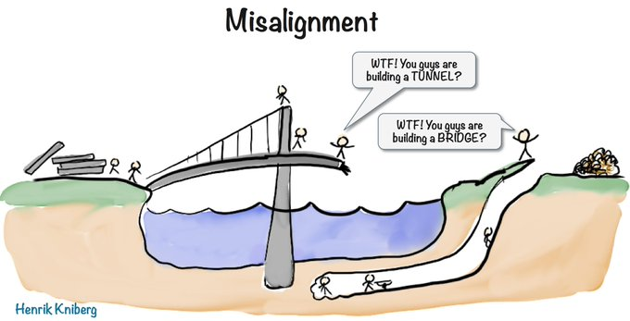
Notes:
There is a reason there are so many articles written about misalignment in hiring
It is the easiest issue to identify but the hardest to fix
Misalignment basically is when the hiring team is not on the same page with the recruiting team
We need to anticipate misalignment with our hiring teams and do what we can to prevent it in order to start the search off on the right foot

Slide 7
Preventing Misalignment
INTAKE… INTAKE… INTAKE
Bring Resumes/Profiles to INTAKE
Pre-Close Hiring Managers
Don’t be afraid to hit the brakes
Notes:
Every chance you have, you should be intaking your requirements with your hiring teams, This is your chance to ask open ended questions and make sure you are on the same page (CLICK)
Bring the job description and pre-sourced resumes to the Intake – better yet show them your search strings
I can’t tell you the amount of times I had a manager look at a job and say “oh why is that in there, they don’t need this certification we listed under mandatory” – Also the search string allows them to see inside our minds and what we consider important to the role (Click)
Pre-closing is great for internal teams – At the end of the intake basically say “so from what I am hearing if I find a candidate that has a top secret, 5 years of Linux admin on a DOD program, is 8570- compliant and has experience spinning up virtual machines… you would eagerly hire them… Is that accurate?”
What we are doing is agreeing on an acceptable candidate or candidate profile (CLICK)
If you continue to submit candidates that meet the profile but are not getting interviewed… it is a sign that the team is not aligned and might be a good idea to pause, circle up and figure out what we are really looking for here.

Slide 8
(Secret OR “security clearance” OR “top secret” OR “top-secret” OR “TSSCI” OR “TS-SCI” OR “top secret SCI” OR “FSP” OR “fullscope” OR “full scope poly” OR “full scope polygraph” OR “ts sci” OR “sensitive compartmentalized information” OR “yankee white” OR “yankeewhite” OR Greenbadge OR “green badge” OR PSD OR “tier 5 clearance” OR SSBI OR “single scope background” OR “single scope background” OR T5 OR “Q clearance” OR clearance OR cleared)
How Many Different ways to say Secret clearance?
🐿 The Search
Notes:
So Asking our hiring teams questions about the job is a pretty obvious example of how we as recruiters need to ask better questions but lets look at our other tools

Slide 9
(8570 OR IATII OR “IAT II” OR “IAT LEVEL II” OR 8570.01 OR “CCNA-Security” OR CySA+ OR GICSP OR GSEC OR Sec+ OR “Sec +” OR Security+ OR “security +” OR “security plus” OR Comptia OR CND OR SSCP OR CAP OR “CASP+ CE” OR CISM OR CISSP OR GSLC OR CCISO OR CCNP OR CISA OR GCED OR GCIH)
How Many Different ways to say IAT II Compliant?
🐿 The Search
Notes:
Knowledge of our industry terms, synonyms and what I call logical alternatives is something we need to constantly be honing in recruiting.
The ability to cast the widest net on qualified candidates is a sure fire way to increase our ability to recruit cleared folks
Remember what I said at the beginning, the supply is not increasing… so we have to get better about seeing what is hiding in plain sight.

Slide 10

🤖 Building an Army of Robots
Notes:
Question – Who in here is worried about AI taking your job?
Question – Who in here is currently using AI in their day to day?
Let me show you a real example of AI completing about a months worth of work in a few minutes:

Slide 11
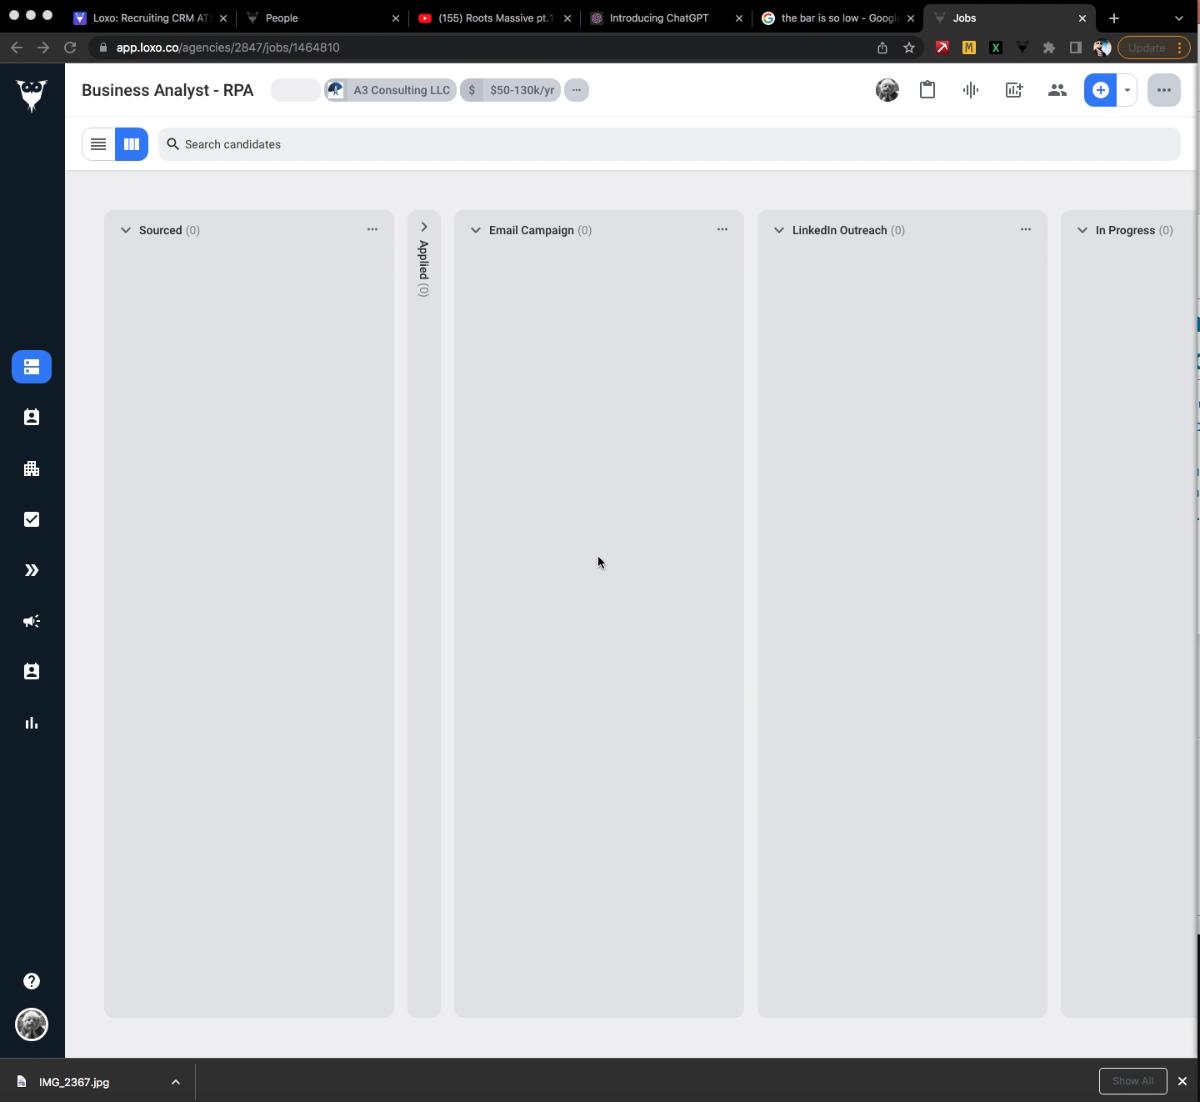

Slide 12
Leverage AI to enhance the redundant part of Recruiting
Sourcing
Drip Campaigns
Resume Formatting
Candidate Write-Ups
Job Descriptions
Boolean Strings
🤖 Building an Army of Robots
Notes:
As the technology gets better we should be looking to replace much of the administrative redundancies with automations
This frees us up to do what we do best – build connections with people
Let’s look at an example of some real prompts that can really enhance your recruiting

Slide 13
ChatGPT Prompts
Explain Kubernetes like I am a 5 year old
🤖 Building an Army of Robots

Slide 14
ChatGPT Prompts
Sure! Imagine you have a lot of toys, and you want to keep them organized and make sure they all work together to have fun. Kubernetes is like a super-duper toy organizer for computer programs, like the ones grown-ups use on their computers.
Here's how it works:
Containers: Think of these like special boxes for your toys. Each container holds a different part of a computer program. For example, one container might hold a game, and another might hold a video player.
Kubernetes: It's like the boss of all the containers. It makes sure all the containers are in the right place and that they can talk to each other. It's like the grown-up who tells you and your friends how to play nicely together.
🤖 Building an Army of Robots

Slide 15
ChatGPT Prompts
Review this resume and provide an analysis on career progression and potential red flags
🤖 Building an Army of Robots

Slide 16
ChatGPT Prompts
Job Hopping: candidate has held several positions over the years, which might be seen as a lack of job stability. However, this can be explained by her transition from military service to the civilian workforce and her pursuit of educational opportunities.
Lack of Direct Experience: Her prior roles, such as working in retail sales and as a sales associate, are not directly related to her current position as an Industrial Security Analyst. While transferable skills may exist, some employers may prefer candidates with more specific experience in security or related fields.
No Detailed Achievements: The resume lacks specific accomplishments, awards, or quantifiable results in her roles. Providing concrete achievements could make her stand out and demonstrate her value to potential employers.
Gaps in Employment: There are some employment gaps, such as a gap between the end of her service in the Army National Guard Reserves and her position as a Security Officer at Allied Universal Security. Chelsea should consider addressing these gaps with a brief explanation in her resume or during interviews.
Education Relevance: The Associate's Degree in Nursing does not directly align with her current career in industrial security. Including relevant coursework or certifications related to security in her education section might strengthen her qualifications.
🤖 Building an Army of Robots

Slide 17
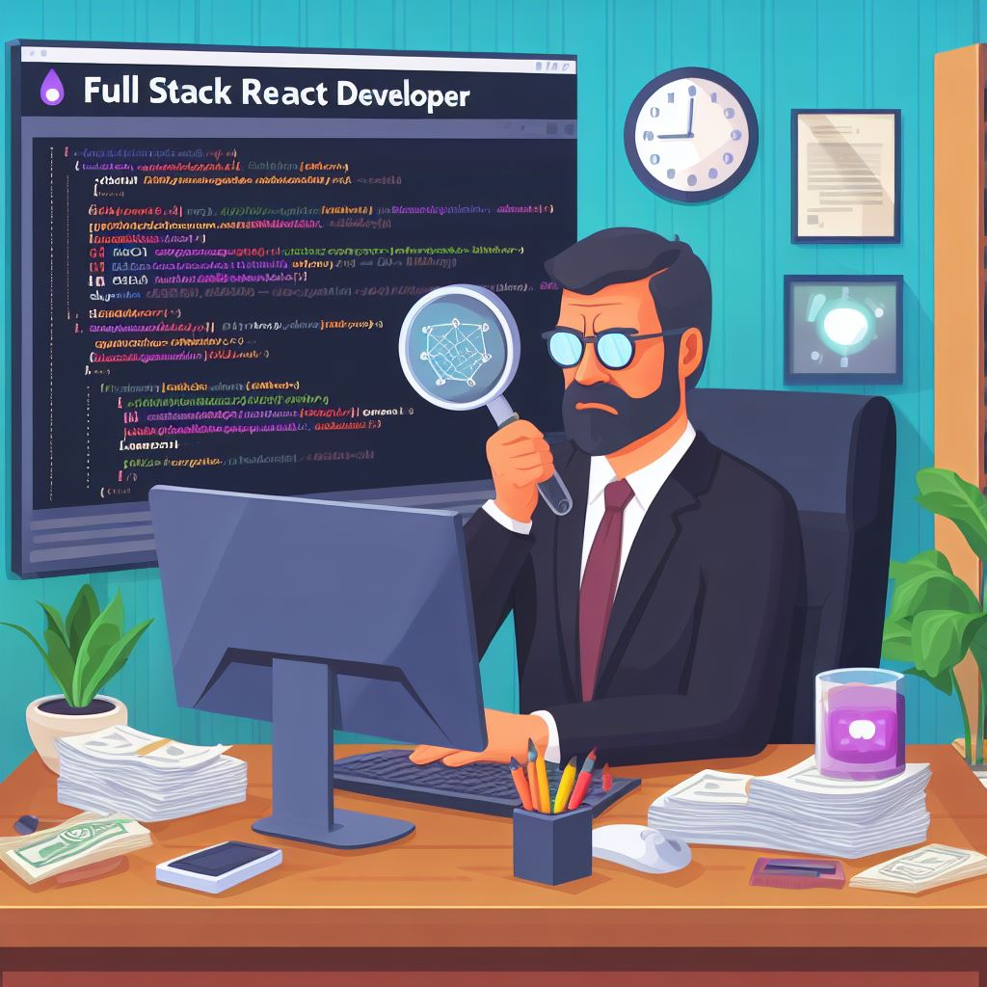
AI – Bing Image Creator | DALL·E 3
PROMPT:
I am creating a job posting for a full stack React developer. I want a picture to go a long with my Social Ad
🤖 Building an Army of Robots

Slide 18

🤖 Outreach
Notes:
Ok – Outreach, this is where everything falls apart – with AI, but in recruiting in general. Most recruiting campaigns fail in outreach, but this is also where we can find the most opportunity.
Recruiting emails are notoriously bad and… all of this AI technology is having the opposite effect on the market.
Now more than ever outreach is important because we are competing with SPAM at an unprecedented amount –so what can we do?

Slide 19

1 thing to do is…
Start communication on the ClearanceJobs Platform
🤖 Outreach
Notes:
One of the main things candidates are concerned with is the legitimacy of the opportunity
When you are communicating “on-platform” you are leveraging the ClearanceJob brand and there is security in that for the candidate
This is a very reputable brand within the industry obviously.

Slide 20

BECOME A TRUSTED ADVISOR
Notes:
Being able to influence better hiring decisions and allowing your company to hire capable people is the quickest way to make hiring cleared candidates easier

Slide 21
EVERYDAY WE HAVE AN OPPORTUNITY TO PROVIDE TALENT AND MARKET INTEL – BUILDING OUR ROLE AS TALENT ADVISOR
STOP SAYING:
“I can’t find anyone”
“we are not paying enough”
”nobody is responding”
Notes:
Obviously the easiest way to become a trusted TA advisor is filling roles quickly, but there is a lot that prevents us from doing that which we don’t control
Always think of your alignment with the hiring team and figure out how to deliver value even when failing
We need to stop saying things like “I cant find anyone” or “we are not paying enough”
All this is doing is is pointing out problems with no solutions…
Instead focus on solutions. “if we were able to flex on the certification requirement and allow them 3 months to obtain it, I have some candidates that are immediately interested and at rate.”
Developing strategy and providing strategic solutions goes so far in being seen as an advisor and almost instantly changes the conversation

Slide 22

How we should be advising our hiring teams
Market Data | Hiring speed
Compensation | Metrics
Application Process | Recruitment Marketing
Tech Stack | Interview Process
Notes:
These are all areas we are experts in
We have a pretty good idea what our competition and market is paying
We feel the pain of the application process
We understand the speed our company needs to move at
Metrics – remember we want our goals to be tied to the business goals, so what should we measure and report on that ties our performance to company goals
And I would say we are absolutely experts at the interview process…
The interview process is an area I think we can be immediately effective – who is sitting in on interviews? I have see some crazy stuff post pandemic and this is an area I think we can have great impact – If your HM’s don’t get trained on interviewing candidates this is a great place to start.

Slide 23
Present With Data
Share Experience
Own the Outcome
Avoid Opinion
BECOME A TRUSTED ADVISDOR
Notes:
When you have the trust of your hiring team – they begin listening.
Nothing is better than when one of my hiring teams outlines the way they want to approach recruiting but then pause and say “but I am really curious to hear how the recruiting team thinks we should approach this”
That is when you know you have their trust and have moved past order taker and into a strategic partner
From the start of the process to the finish it is a great practice to Always present with data – non biased fact based –
Share experiences – similar situations how did they work out
Own the recruiting process especially the outcome – learn adapt
And avoid opinion’s without esperience

Slide 24


IM A
UNICORN
Notes:
A huge part of the issue with hiring is we are constantly looking for things that don’t exist
Like… Unicorns
Or Purple Squirrels
OR unicorn, rockstar purple squirrel hybrids.

Slide 25

I read your profile in WBJ and I am so glad I did... From the broken bones, travel and Teenage Mutant Ninja Turtles, it Redacted -
I read your profile in WBJ and I am so glad I did... From the broken bones, travel and Teenage Mutant Ninja Turtles, it really was an enjoyable profile to read. Something you said in there stuck out to me, it was the line about GovCon customers paying a reasonable wage. This continues to be such an issue in the security clearance recruiting market and I would argue the issue has gotten worse in the last 3 years. Covid really shook things up and has caused a dramatic increase in salaries especially for mid level cleared talent.
That is the pain we are all facing. I know you have in-house recruiting team and may be hesitant to speak with vendors, but I also know your next big win is right around the corner and a trusted vendor to supplement your in-house efforts is a great thing to have.
We are experts at cleared recruiting - lead by a team that understands the space from proposal to execution. We are reliable, fast and are built specifically to support small to mid-sized government contractors.
I would love to opportunity to meet and learn more about your growth and recruiting strategy.
My Great sales Email

Slide 26
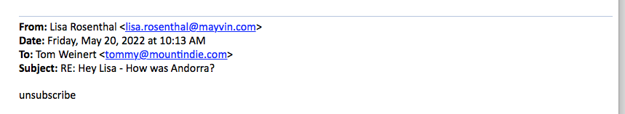
My Great sales Email

Slide 27

Thank You
Tommy@mountindie.com
Let’s take a Selfie!
BYE BYE!

