Slide 1
Trusted Workforce 2.0
Connect 2023
Patricia Gaviria
Chief, Personnel Security
Special Security Directorate
October 19, 2023

Slide 2
Background:
What is personnel security vetting?
Government Personnel Vetting Domains
National Security
Trusted with access to classified information (through a security clearance)
Suitability / Fitness
Trusted to work for, or on behalf of, the Federal Government
Credentialing
Trusted with a badge granting physical/ logical access
1

Slide 3
Background:
Personnel Security Process
Determination made my hiring/requesting agency confirming the security clearance requirement.
Applicant completes investigative documents and provides to hiring/requesting agency.
Hiring/requesting agency sending Investigative Request to Investigative Service Provider (ISP).
Initiation
Investigative Service Provider initiates background investigation.
  Information gathered on applicant.
Investigation
Hiring/requesting agency conducts adjudication.
Clearance determination is made.
Adjudication
2

Slide 4
Background:
Adjudication Process
Whole of Person Concept
School
Law Enforcement
Interviews
Employers
BI Results
Credit
Records Checks
National Security Adjudicative Guidelines
Allegiance to the United States
Foreign Influence
Foreign Preference
Sexual Behavior
Personal Conduct
Financial Considerations
Alcohol Consumption
Drug Involvement and Substance Misuse
Psychological Conditions
Criminal Conduct
Handling Protected Information
Outside Activities
Use of Information Technology
Nature & Extent | Frequency | Recency | Maturity | Motivation Rehabilitation | Potential for Pressure
3

Slide 5
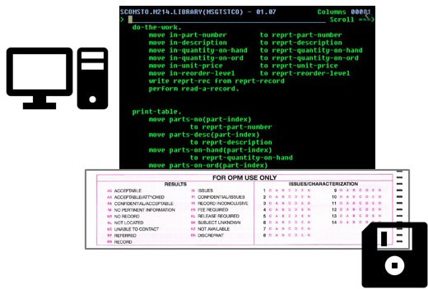
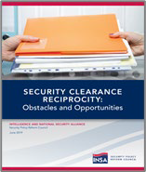
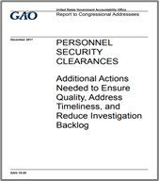

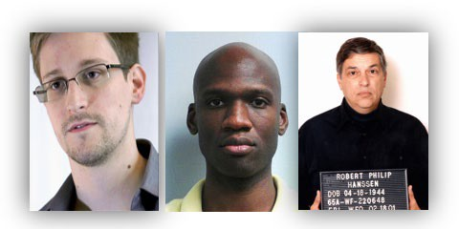
Why does personnel security vetting need reform?
Alignment to 21st Century Mission Needs | Modernizing Technology
Evolving Societal Norms | High Cost of Failure
4

Slide 6
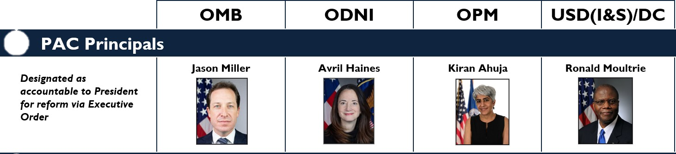





TRUSTED WORKFORCE 2.0
Performance Accountability Council (PAC) Principals
Security Executive Agent
Suit/Cred Executive Agent
Rapid delivery of a trusted workforce to execute the missions of Government.
Improved workforce mobility better responds to changes in mission needs.
Increased insight provides strategic risk management and protects the mission.
OBJECTIVES
MISSION
MOBILITY
INSIGHT
National Background Investigation Services (NBIS) provides end-to-end personnel security vetting services
Eliminates traditional periodic background investigations
Aligns investigative tiers and reduces them from five to three
5

Slide 7
CONTINUOUS VETTING
Trusted Workforce (TW) 2.0 is built around Continuous Vetting (CV), which includes:
  automated record checks
  self reporting
  agency-specific information
  event-driven information
As of June 2023, over 4.5 million individuals are enrolled in a TW interim capability.
BENEFITS of CV
Early detection
Intervention
Wellness & Support
Retention of the Workforce
PREVIOUS MODEL:
Periodic Reinvestigation
TRUSTED WORKFORCE 2.0:
Continuous Vetting
6

Slide 8
POLICY PROGRESS
Released:
Guidelines & Standards
On the horizon:
Implementation Guidance
Federal Personnel
Vetting Guidelines
Federal Personnel Vetting
Investigative Standards
Investigative Standards Implementation Guidance
Feb
2022
May
2022
Performance Management
Implementation
Guidance
Common Principles for Applying Federal Personnel Vetting Adjudicative Standards
Federal Personnel Vetting Performance Management Guidelines
July
2022
Feb
2022
Federal Personnel Vetting
Performance Management
Standards
Personnel Vetting
Performance Management
Standards
Implementation Guidance
Federal Personnel Vetting Engagement Guidelines
Feb
2022
Sept
2022
7

Slide 9
On the Horizon:
Performance Management Implementation Guidance (PMIG)
The Executive Agents (ODNI and OPM) will be releasing the Implementation Guidance to pair with 2022’s Performance Management Standards VERY SOON
  The PMIG establishes many performance measures assessing the end-to-end timeliness of personnel vetting, as well as segments of the vetting process.
PMIG Compared to IRTPA – a Sample
 | IRTPA | PMIG
Vetting Population | 90% fastest | 100%
Personnel Security Process Timeline | Clock starts when security receives investigative and application documents from individual | Clock starts when conditional offer is sent to application
By including the slowest 10% we will have better insight into the most complicated of clearances cases. To improve the process we must first identify the problems.
Starting the process timeline when the conditional offer is sent will give visibility into how long it takes to complete the initial phase of paperwork/application and if there are hurdles that can be mitigated by the agencies.
8

Slide 10
On the Horizon:
Annual Vetting Appraisal
Going forward
More complete picture into the health of the workforce.
Allows agencies to help their workforce to get the help they need earlier and create a reduction of risk for all parties!
Annual Vetting Appraisal (AVA)
  Annual wellness and security check
  Completed by the individual and supervisors
Continuous Evaluation
  Automated ongoing checks
Historically
Large gap in time where issues are left to fester creating a 5 year risk period.
Standard Form 86 (SF86)
  Every 5 years
  Completed by individual
Periodic Reinvestigation
  Every 5 years
9

Slide 11

HOW TO PREPARE
Start Early
Review and understand the SF-86 – soon to be Personnel Vetting Questionnaire (PVQ)
Start gathering your information now
  Compile your list, with timelines, of past addresses, employers, and contacts
Think about your prior activities/behavior
  It is better to disclose because the whole of person concept!
Look at your online presence - see what is says about you
Give a head's up to friends/references. After you get a conditional job offer and complete your paperwork
Keep looking at USA jobs and other agency websites for vacancies
10

Slide 12
Learn more about Trusted Workforce 2.0 by visiting:
www.performance.gov/trusted-workforce
11

